Slide 1
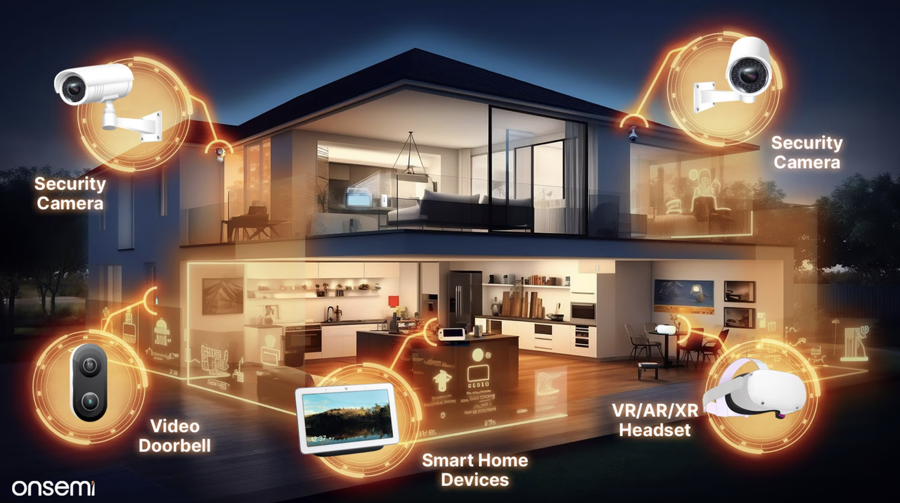
Camera-Based Occupancy Sensing Using AI for Smart Home Applications

Slide 2
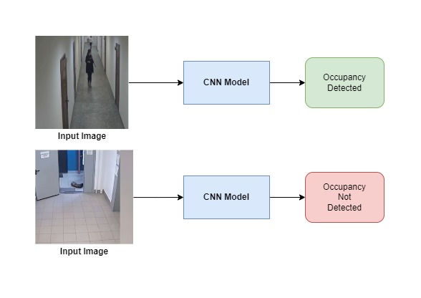
Introduction & Objective
Objective: Develop an AI-driven real-time occupancy detection system for smart homes.
Key Technologies:
Convolutional Neural Networks (CNNs): ResNet50, MobileNet V3, EfficientNet B0.
Advanced Data Collection: Leveraged hospital footage and diverse datasets.
Main Features:
Real-time human presence detection.
Robust performance in varying conditions.
Optimized for efficiency.
Figure 4: Different scenarios of the camera-based occupancy sensing process

Slide 3
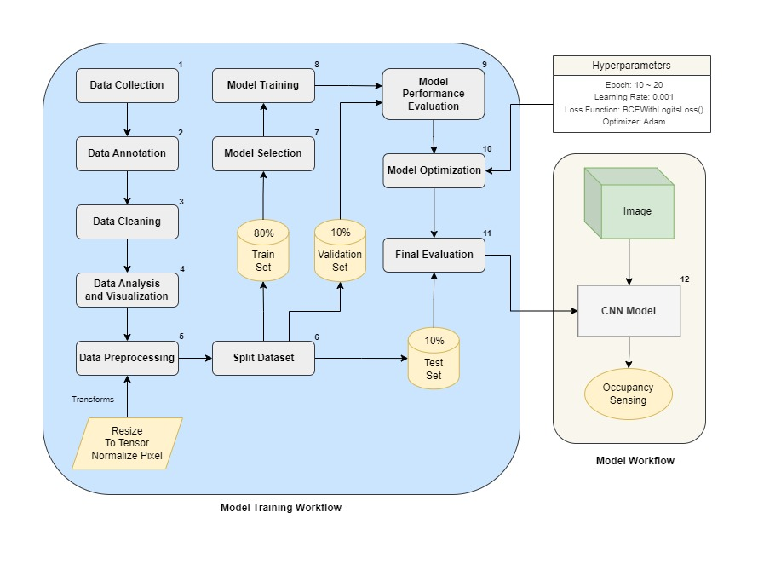
System Design
System Components:
Hardware: Sensors, cameras, and microcontrollers required for deployment in real life.
Software: CNN models implemented in PyTorch for image classification.
CNN Models Overview:
ResNet50: Deep architecture for high accuracy.
MobileNet V3 Large: Efficient for mobile and embedded devices.
EfficientNet B0: Balances performance and computational efficiency.
MobileNet V2: Lightweight, suitable for resource-constrained environments.
Figure 2: Software Block Diagram Specifications for ML

Slide 4
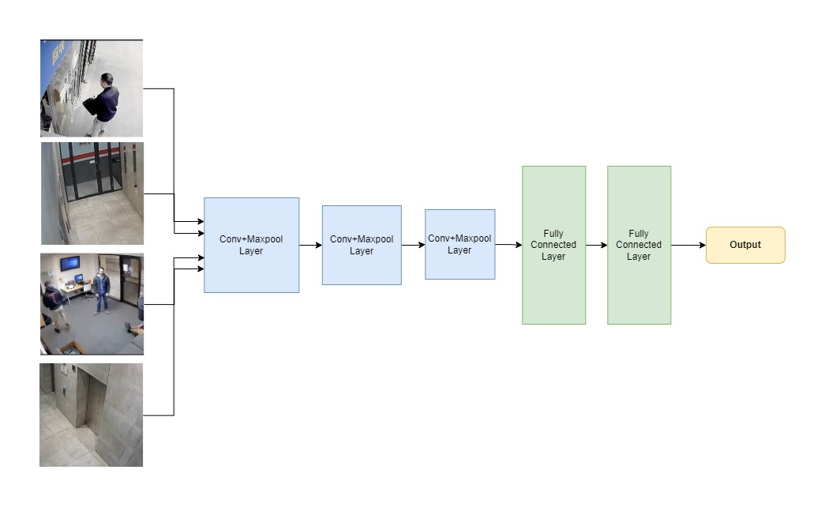
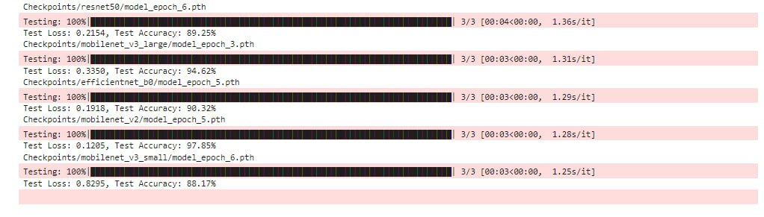
Implementation & Results
Data Handling & Preprocessing:
Data Collection:
Extracted frames from hospital videos and other sources.
Diverse scenarios for comprehensive model training.
Data Preprocessing:
Handled variability in lighting and environments.
Applied data augmentation techniques.
Model Training & Optimization:
CNN Models: ResNet50, MobileNet V3, EfficientNet B0, MobileNet V2.
Optimization Strategies:
Enhanced parallel processing.
GPU acceleration for improved speed and efficiency.
Figure 3: Model Implementation & Result

Slide 5
Conclusion & Future Work
Advanced Sensor Integration:
Proposal: Incorporate thermal imaging and depth sensors to enhance accuracy.
Scalability:
Proposal: Develop a distributed version for larger datasets and complex environments.
Continuous Learning:
Proposal: Implement AI-driven continuous learning frameworks to adapt to changing occupancy patterns.
Conclusion:
This project marks a significant step in enhancing smart home technologies, ensuring adaptability and future-proofing through continuous improvements.

